Slide 1
International football data analysis
Pillutla Sony

Slide 2

TOPICS COVERED
Introduction
About dataset
Workflow
Data cleaning
Data modelling
Creating dimensional & fact table
Loading data into HDFS
Creating tables in Hive
Loading data into tables in Hive
Queries

Slide 3
introduction
This Data set Contains records of all the International football matches that took place between Year 1872 and 2019.
The matches range from FIFA World Cup to FIFI Wild Cup to regular friendly matches.
The matches are strictly men's full internationals and the data does not include Olympic Games or matches where at least one of the teams was the nation's B-team, U-23 or a league select team.

Slide 4
ABOUT DATASET
Date-Date of the match.
home_team-Name of the home team.
away_team-Name of the away team.
home_score-Home team goals.
away_score-Away team goals.
Tournament-Tournament name.
City-City where the match took place.
Country-Country where the match took place.
Neutral-Whether the match took place at a neutral venue or not.

Slide 5
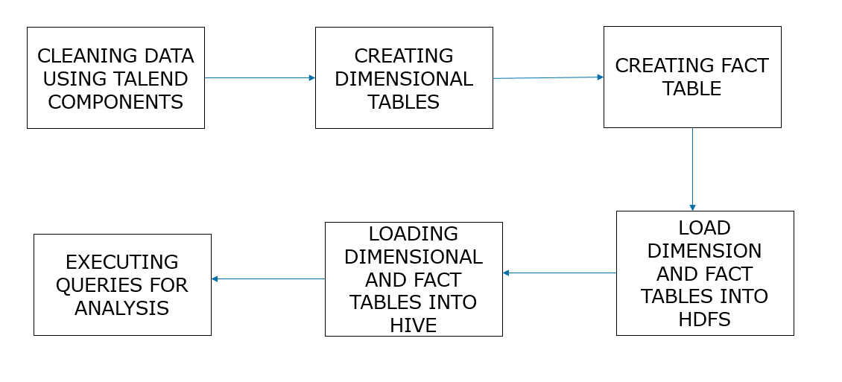
workflow

Slide 6
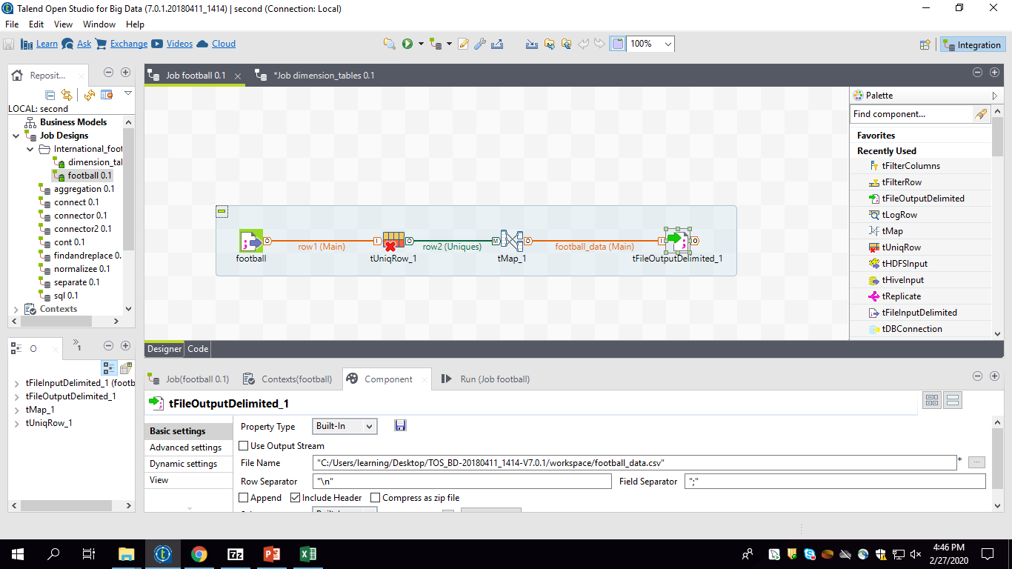
Data cleaning using talend
Data cleansing or data cleaning is the process of detecting and correcting (or removing) corrupt or inaccurate records from a record set, table, or database and refers to identifying incomplete, incorrect, inaccurate or irrelevant parts of the data and then replacing, modifying, or deleting the dirty or coarse data.

Slide 7
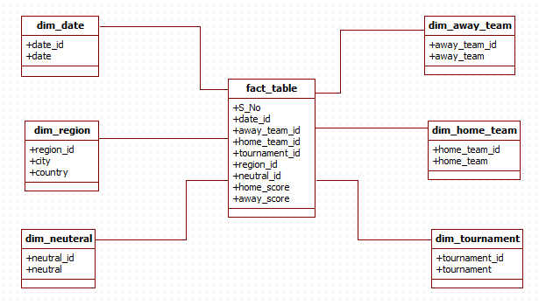
Data modeling

Slide 8
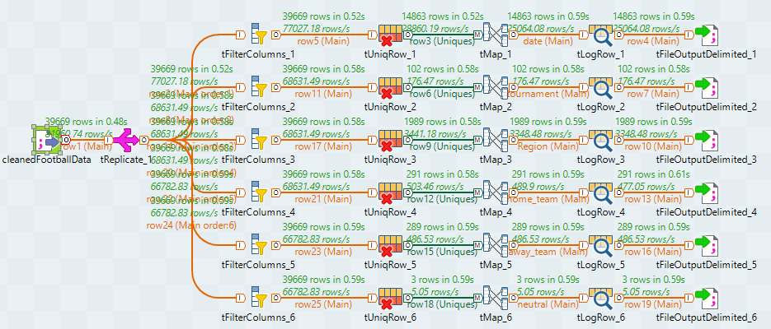
Creating dimension tables

Slide 9
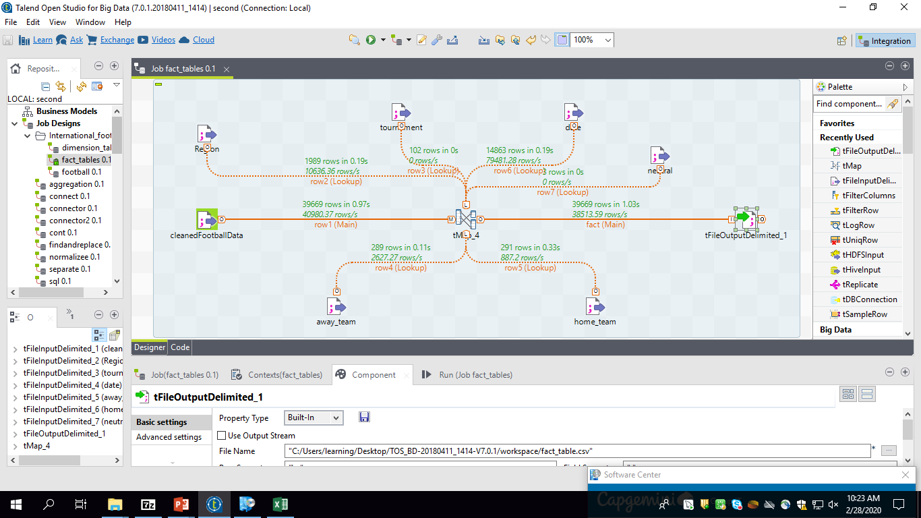
Creating fact table

Slide 10
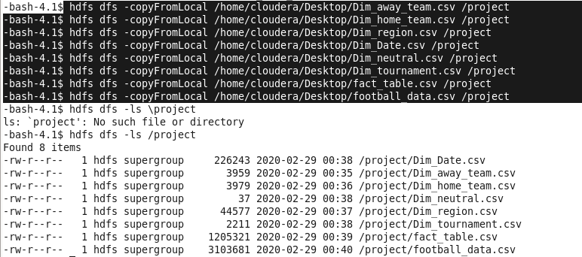
Loading data into Hdfs

Slide 11
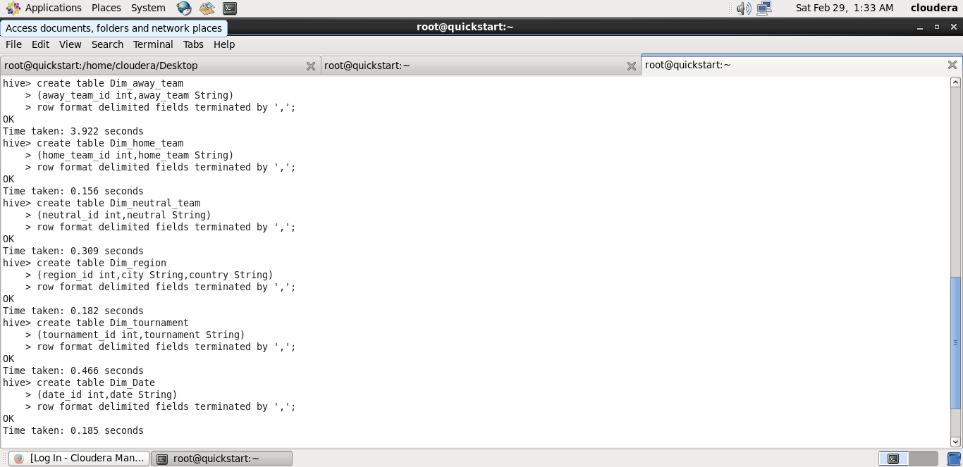
Creating tables in hive

Slide 12
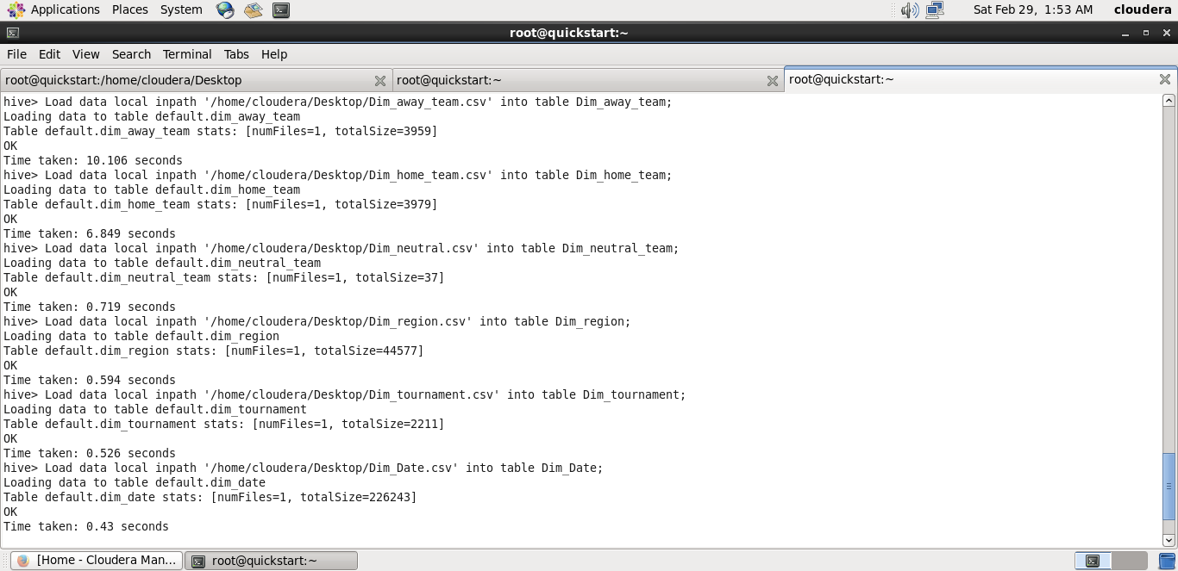
Loading data in hive tables

Slide 13
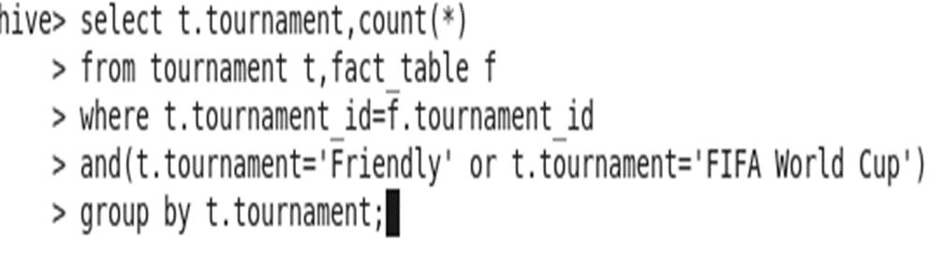
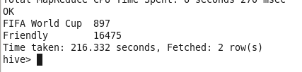
1.NO. OF MATCHES PLAYED IN FIFA World Cup and Friendly MATCH
Query:
Output:

Slide 14
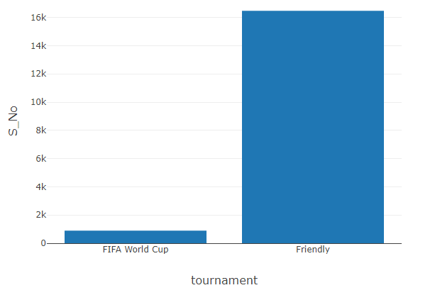
Graphical representation No. of matches played in FIFA World Cup and Friendly match

Slide 15


2:Neutral frequency analysis for all the cities
Query:
output:

Slide 16
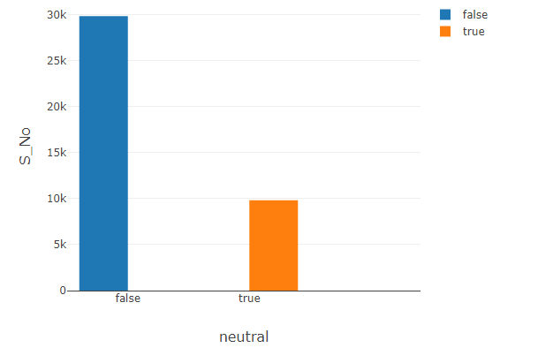
GRAPHICAL REPRASENTATION OF NEUTRAL FREQUENCY FOR ALL CITIES

Slide 17

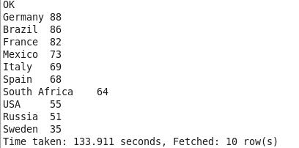
3:COUNTRIES HOSTING MOST MATCHES FOR ‘FIFA World Cup’
Query:
Output:

Slide 18
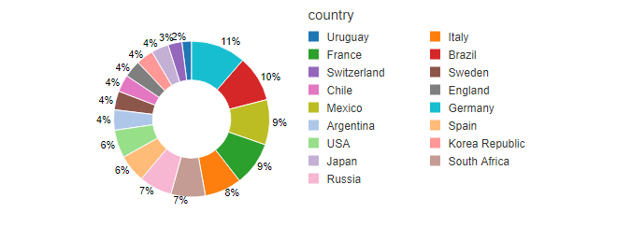
GRAPHICAL REPRESENTATION OF COUNTRIES HOSTING FOR ‘FIFA World Cup’

Slide 19
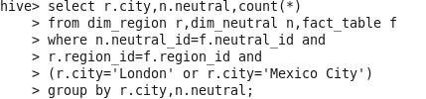
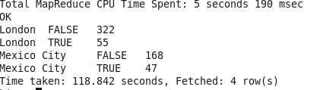
4:Neutral frequency analysis for London and Mexico City
Query:
Output:

Slide 20
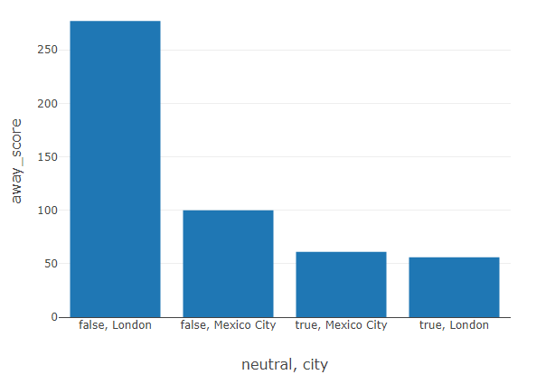
Graphical representation of Neutral frequency for London and Mexico City

Slide 21


